Slide 1
Symptom-Based Disease Prediction Model
AI Boot Camp Project 3
Team Members:
Anand Bhagwat
Jean Clark
Usha Hariharan
Alexander Iruthaya

Slide 2
Project Description
This project aims to create a machine-learning model capable of predicting diseases based on user input symptoms.
The model will use a reliable dataset, the Symptom-Disease Prediction Dataset (SDPD), to train and evaluate predictive algorithms.
Output will include a customer-facing app that provides preliminary diagnoses and possible remedies based on the symptoms provided by the user.

Slide 3
Project Goals
Develop a reliable, symptom-based prediction model
Implement a user-friendly application for public use

Slide 4
Data Extraction
Dataset: Symptom-Disease Prediction Dataset (SDPD)
Source: Tucker, Jay (2024), "SymbiPredict", Mendeley Data, V1, doi: 10.17632/dv5z3v2xyd.1
Description: A comprehensive and structured dataset linking symptoms to various diseases, rated as "reliable" by medical institutions and professionals, including the CDC.
Format: CSV

Slide 5
Data Cleaning & Preprocessing
Handling missing or inconsistent data
Different format data was looked at
Cleaned data to replace NaN values with 0s
Visualized dataset for diseases, symptoms, occurrence frequencies)
Normalizing and encoding symptom data.
Splitting the dataset into training, validation, and testing subsets.
Three models—MLP, CNN, RNN, RandomForest with LSTM

Slide 6
Exploratory Data Analysis
Visualized key feature distributions and their relationships
Examined correlations between variables.
Visuals on next slides:

Slide 7

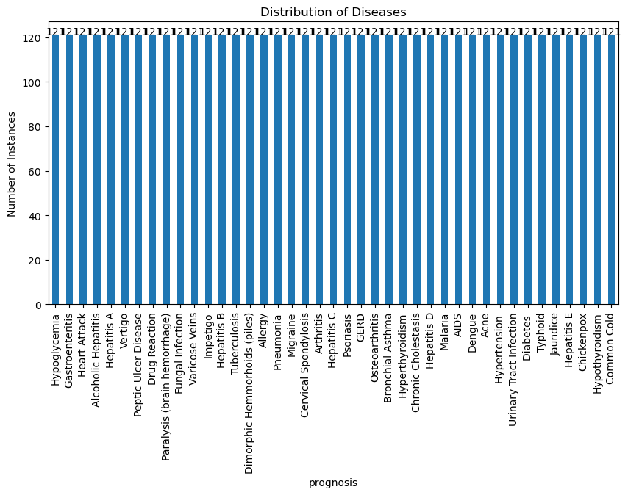

Slide 8
Display of clean dataset
(output 2)

Slide 9
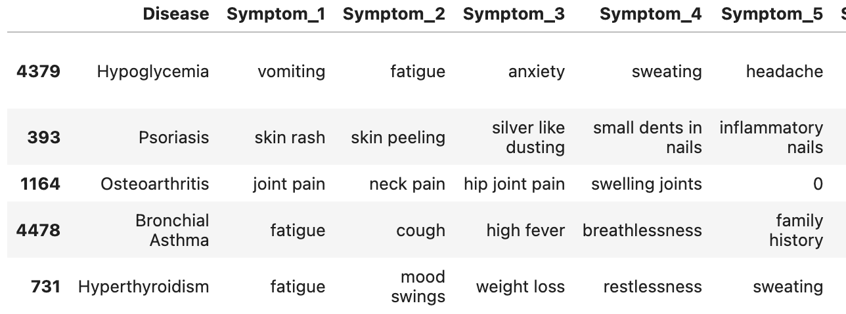
Dataset – Grade Assignment as a function of
symbipredict dataset (table of cleaned dataset)

Slide 10
Project Methodology
Approach taken to achieve goals
Feature Importance:
Identified top attributes such as `disease’ and ‘symptom out of 49 diseases and 132 symptoms
Visualized feature importance using horizontal bar plots (next slide)

Slide 11
Model Optimization & Evaluation
Model Optimization and Evaluation (accuracies of all models) 1.0
Split data into training and testing sets. (60-40)
Scaled features using ‘Label Encoder’---ordinal variables(copy)

Slide 12
Model Optimization & Evaluation
Model Optimization and Evaluation
Trained multiple models
1.
2.
3.
Decision Tree: 67%
Random Forest: 67%
XGBoost : 89.8%

Slide 13
Result/Conclusion 1 --
-1
MODEL PERFORMANCE: RANDOM FOREST
Random Forest achieved a testing accuracy of 67%
High accuracy effectively classifies , and can identify default risks
High-impact features such as provides predictive power

Slide 14
Result/Conclusion 2 --
MODEL PERFORMANCE: XGBoost
XGBoost**: Precision, Recall, and F1-scores close to 1.0 for all classes.
XGBoost achieved near-perfect precision, recall, and F1-scores
Overall accuracy rate of 99%
Handled imbalanced classes by focusing on the most significant features

Slide 15
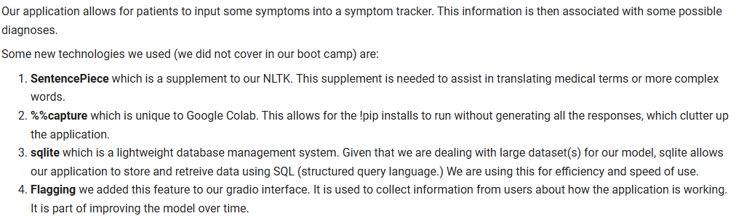
Disease Prediction Application

Slide 16
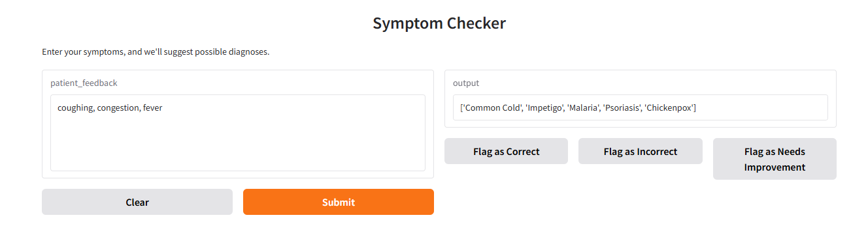
Disease Prediction Application

Slide 17
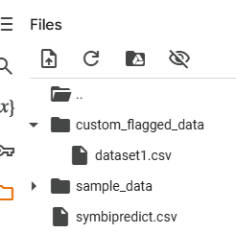
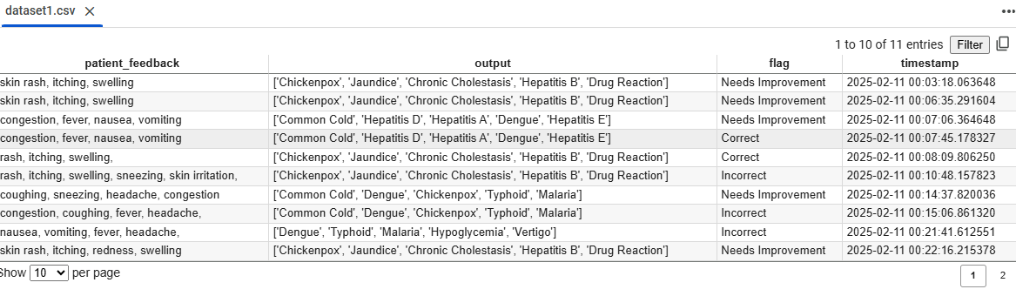
Disease Prediction Application Output from our ‘flagging’ tool built into Gradio

Slide 18
Summary
Machine learning model created using Grade as the determinant has a better predictor of credit risk
Machine learning model created using loan status as the determinant has less predictive accuracy of credit risk
The grade and loan status were chosen as Y values to determine borrower credit risk
Grade provided better accuracy than loan_status
(Switch to Project 3 data)

Slide 19
Problems Encountered
Data Quality: Size of data sets were large and difficult for Github to process for expedient analysis
Class Imbalance: Resulting from XGBoost, same number of components were not used in classification report for 0 and 1 values
Even with n_estimators = 200, the accuracy for loan status was subpar
High Dimensionality: Selection of models to utilize was difficult; for example, SMOTE was dropped due to poor results, it also cannot process NaN values, this changed all the scores
(switch to Project 3 data)

Slide 20

FUTURE ML ENHANCEMENTS:
Hyperparameter Tuning: Incorporating hyperparameter optimization for Random Forest and XGBoost to improve performance further.
Additional Datasets: Our models can be further validated with additional datasets to ensure they generalize well with other types of loans
Real-time Dashboard: Live dashboard can provide real-time credit scoring and loan risk assessments
Avoid Project overview only on titles
The approach that your group took in achieving the project goals. Please provide a prediction method for any new data point to get the prediction. (4 / 5 points)
(Project 3 data)
Future Considerations

Slide 21
FUTURE FORWARD CREDIT CONSIDERATIONS:
Emerging / alternative data sources: social, connected device data
Environmental/social sustainability metrics: spending pattern alignment with ethical and community welfare practices
Blockchain and decentralized credit scoring: scoring metrics based on smart contracts, blockchain transactions, and wallet activity
Real-time and Dynamic scoring: real-time analysis of transactions and adjustments for critical life events
Ethical and Inclusive models: bias-resistant models, creating nontraditional scoring models that support credit extension to underserved populations
Network-based creditworthiness: peer influence models, group creditworthiness
Hybrid models: FICO+ ML derived alternative data (project 3 data)
Future Considerations

Slide 22
FUTURE FORWARD HEALTH TECH CHALLENGES:
Key Challenges to Address
While these paradigms offer tremendous potential, they also present challenges:
Data Privacy and Security: Safeguarding sensitive consumer data.
Fairness and Bias Mitigation: Ensuring equitable access and avoiding systemic bias.
Regulatory Compliance: Aligning innovations with strict regulatory frameworks.
User Trust: Building confidence in nontraditional scoring methods.
Exploring these paradigms in credit risk can revolutionize financial inclusion, improve risk accuracy, and cater to the evolving financial ecosystem.(project 3 data)
Future Considerations

